Slide 1

DOSRI AMPLIFYING SOCIALLY RESPONSIBLE INVESTING (SRI) PRESENTATION 8
Team 1: Six Underground
Presented by:
Farhan Pasha Mohammed
Samarth Yadav
Harshal Patil
Kush Shah
Jephthe Louis-Jacques
Naga Sai Kiran Nimmakayala
Instructor: Henry Wong

Slide 2

AGENDA
1. TEAM MEMBERS ROLES 11. PRODUCT BACKLOG
2. PROBLEM STATEMENT 12. SPRINT BACKLOG
3. PROJECT DESCRIPTION STORIES AND ACCEPTANCE CRITERIA
4. PERSONAS TEST CASES FOR STORIES
5. MVP 13. METRICS
6. TECHNOLOGIES 14. RETROSPECTIVE
7. CONCEPTUAL ARCHITECTURE 15. SPRINT 8 STORIES
8. SPRINT 1 to 4 RECAP 16. PROJECT DEMO - GITHUB LINK
9. SPRINT 5 TO 7 RECAP
10. IMPROVEMENTS
Notes:
need change

Slide 3
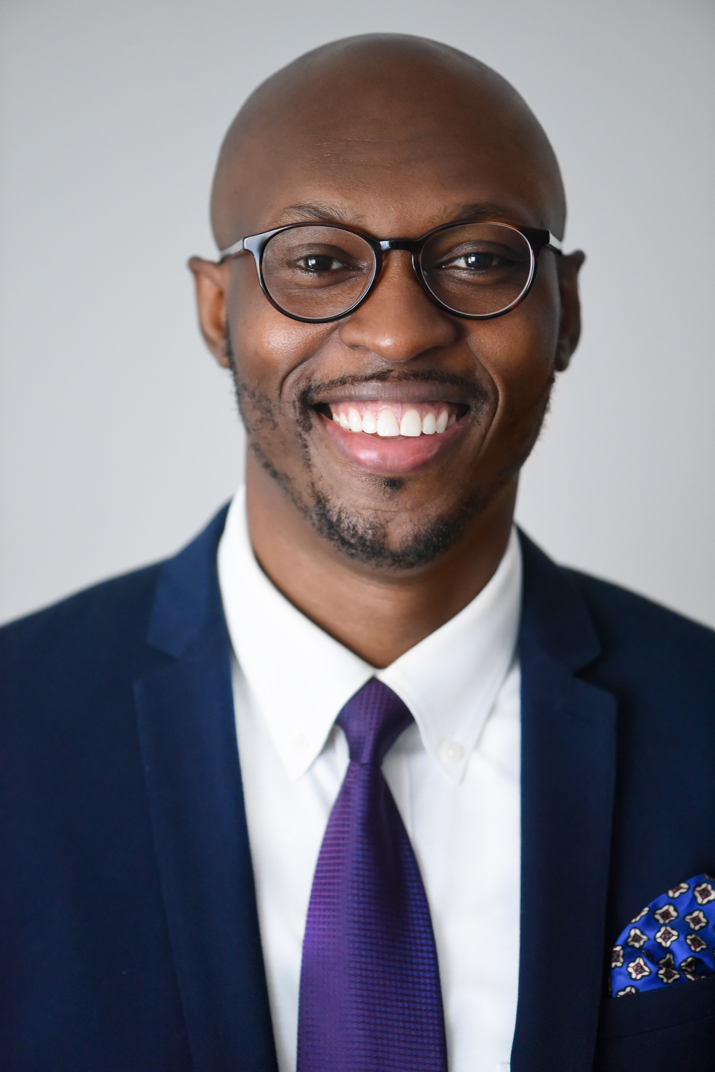



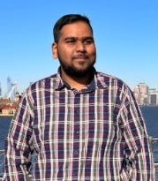

Team Members
Jephthe Louis-Jacques
Harshal Patil
Samarth Yadav
Kush Shah
Farhan Pasha Mohammed
Naga Sai Kiran Nimmakayala
Scrum Master
Developer
QA Analyst
Developer
Cloud Engineer
Tester

Slide 4
PROBLEM STATEMENT
As more investors commit to investing in companies that are socially responsible, these progressive investors struggle to find the metrics that go beyond traditional line items such as traditional performance and expenses. Socially conscious investors struggle to find the metrics that highly business practices that align with their values.
Here is the opportunity we plan to capitalize on, “DOSRI” is a free website that provides investors insight about publicly traded companies social rating base on the ‘Environmental, Social, & Governance’ (ESG) standard rating. Dorsi plans on serving this growing community of investors with thorough analysis of company performances that expand beyond traditional financials along with quick access to investing in these Socially Responsible companies.
Notes:
COMPLETED

Slide 5
PROJECT DESCRIPTION
WHAT IS DOSRI?
“Dosri” is a free website that provides investors insight about publicly traded companies social rating base on the ‘Environmental, Social, & Governance’ (ESG) standard rating and more.
Provides investors with latest stock price, related articles and third-party brokerages accounts for creating investment accounts if interested in buying the stock
The differentiator with the site is to amplify Socially responsible investing amongst investors by quickly helping them identify companies that are sustainable, particularly in in the three categories below:
Environmental - Issues such as climate change and pollution
Social - Issues around workplace practices and human capital
Governance - Issues such as executive pay, accounting, and ethics
Socially Responsible Investing (SRI)
Notes:
COMPLETED

Slide 6
PERSONAS

Slide 7
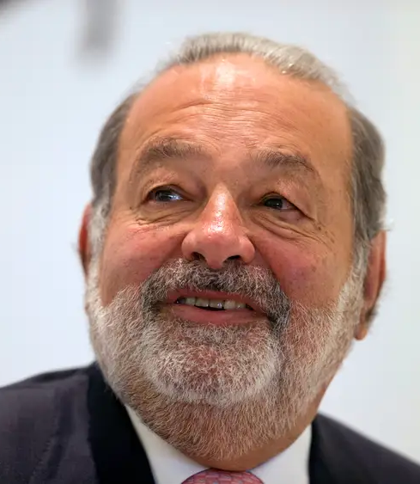
PERSONA 1: CARLOS, PUBLIC SPEAKER
Background Profile:
Carlos, a 60 years old, wealthy long-term investors that does financial public speaking, runs his own family office, always looking for new tools to make better investment decisions
Carlos likes to research companies and read the latest stories about them to quickly identify their long-term financial positions
How Dosri can help?
Carlos can search various publicly traded companies on Dosri and review their financials.
Dosri simultaneously provides google articles related to the searched company for additional insight on performance.
Carlos can search companies on Dosri to gather metrics to better inform his audience of the top performing ESG companies.

Slide 8

PERSONA 2: DONNA, RECENT GRADUATE
Background Profile:
Donna, a 24 years old, recent college graduate that major in product design, currently making 120K USD, identifies as a vegan and cares about the environment.
She sees the value of investing her dispensable money, but she is new to the finance and conscious of companies that are known for conducting unethical practices.
How Dosri can help?
Donna can search various publicly traded companies on Dosri and review their financials.
Dosri simultaneously provides google articles related to the searched company for additional insight on performance.
If Donna is ready to make an investment, Dosri provides quick access links to investment brokerages at real time.

Slide 9
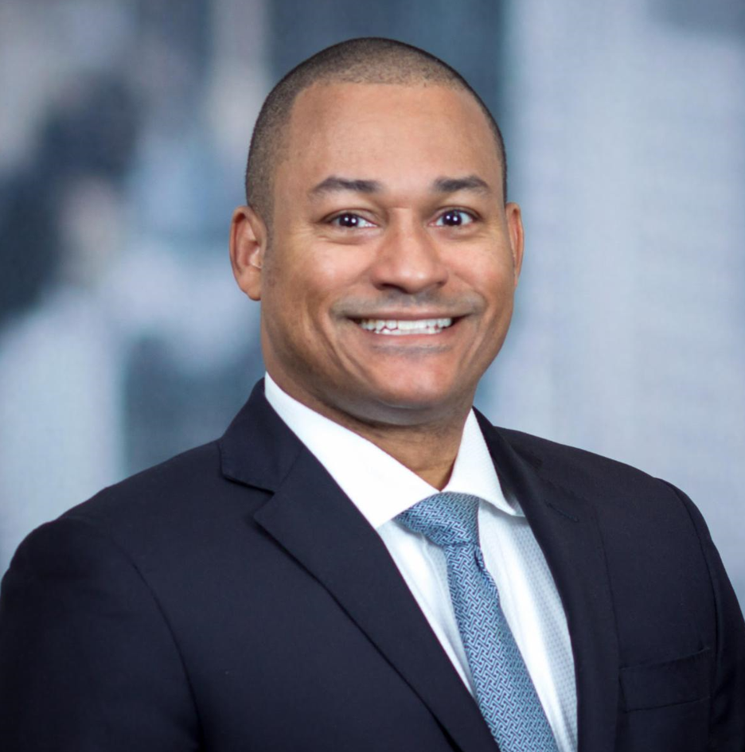
PERSONA 3: PAUL, INVESTOR
Background Profile:
Paul, 26 years old, a recent college graduate working as an investment advisor at a Bank, is aiming to bring more value himself to the Bank and all the customers.
His thinking is not only are investments in socially responsible assets vastly growing. The market shows that this interest stems to a significant extent from investors trying to align their investments with their social preferences.
How Dosri can help?
Dosri helps Paul as he can review SRI companies with a sustainable business plan and can get more accurate information for investment.
Dosri helps provide insights into the company’s financial growth with user friendly UI.
As Paul is completes his review process; Dosri provides quick links to investment brokerages in real-time.
Notes:
Kiran

Slide 10
MINIMAL VIABLE PRODUCT (MVP)
Features:
Provide stock price, ESG standard rating, Financial reports for the company currently being searched
Allow user to login and create password to store their historical search data
Generate latest online news for company currently searched
Provide quick access to third party platform investment firm (Fidelity)

Slide 11




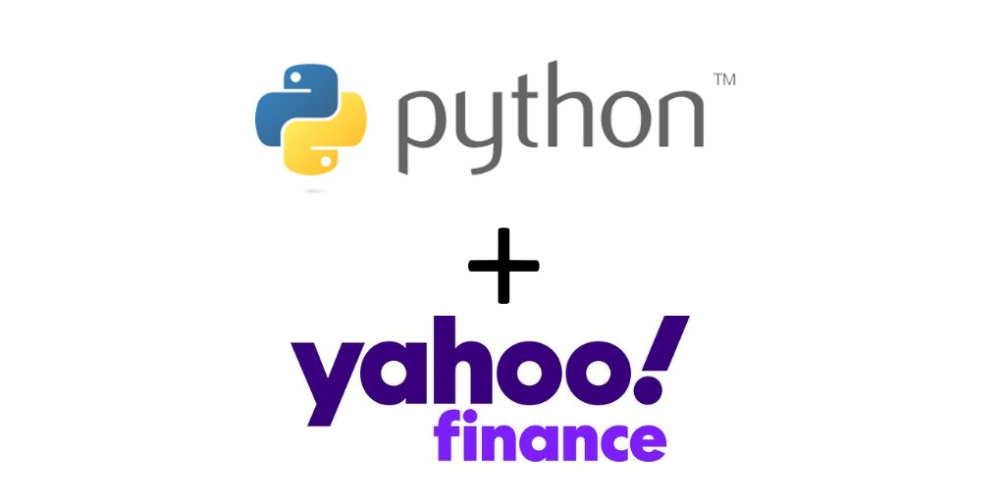

TECHNOLOGIES

Slide 12
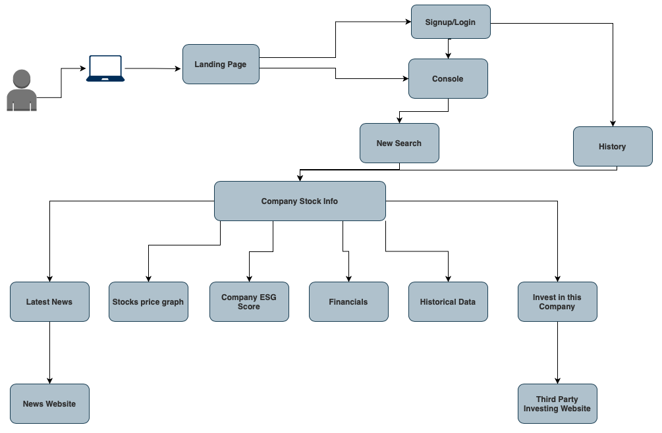
CONCEPTUAL ARCHITECTURE
Notes:
1 TO 5 Kiran
6 to 12 Farhan

Slide 13
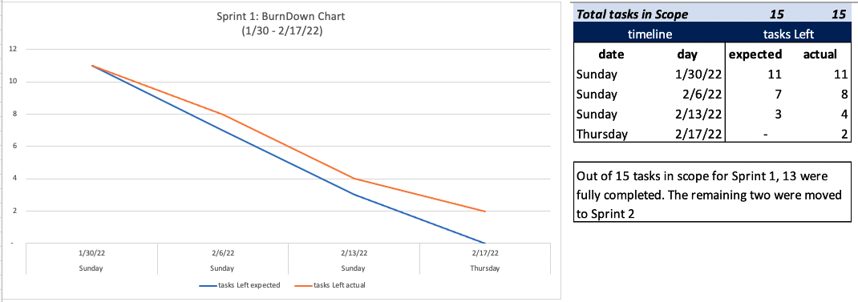
SPRINT 1 TO SPRINT 4 RECAP
Sprint 1:
Describe project & Output Goals
Created personas for user base
Constructed write detail customer journey for UI/UX

Slide 14
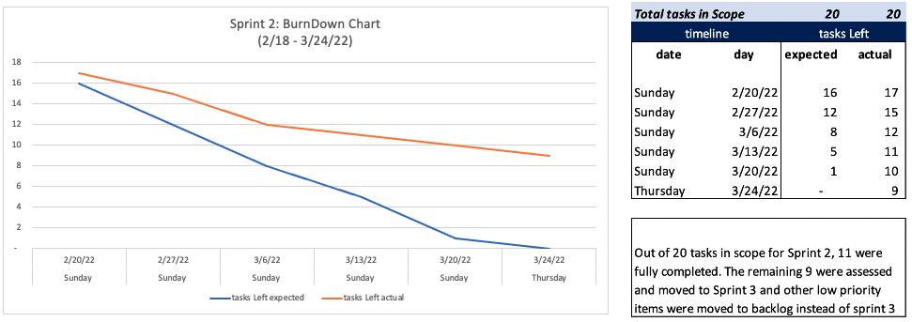
Sprint 2:
Identified APIs available for for company stock prices
Created Database schema for objects and attributes
Created sketch of tentative UI

Slide 15
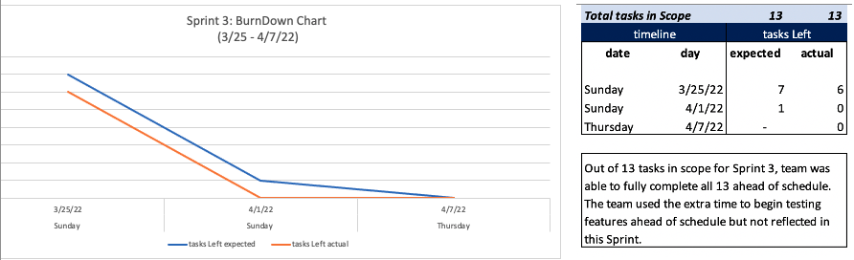
Sprint 3:
Created website UI/UX
Coded the front end UI with CSS/HTML
Impleted Yahoo Finance API

Slide 16
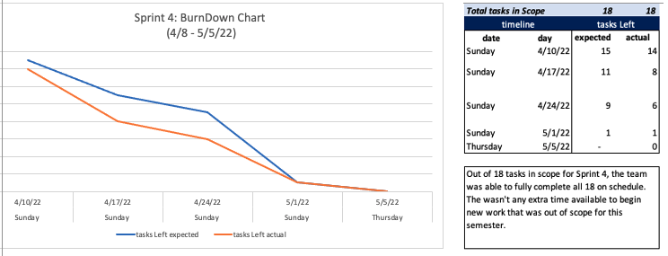
Sprint 4:
Created Test cases for user stories
Revised user personas based on professor feedback
Logged Product Roadmap in anticipation of Fall’22 project goals
Make changes to previous bugs related to API and UI
Notes:
Farhan

Slide 17
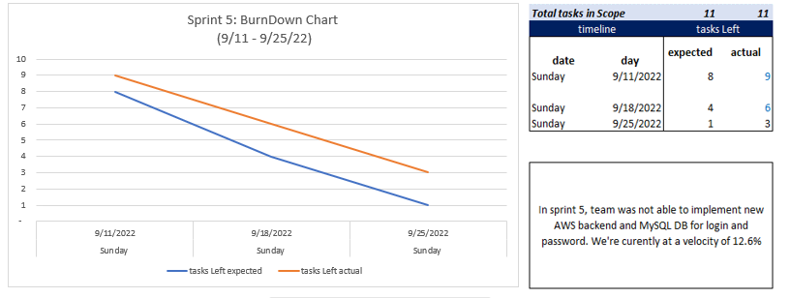
SPRINT 5 TO SPRINT 7 RECAP
Sprint 5:
Enhanced the front end UI with CSS/HTML.
Researched on backend for for implementing new features that requires RDS (i.e. AWS)
We included data metrics in dynamic visualization tool i.e., Graph.
Notes:
Samarth

Slide 18
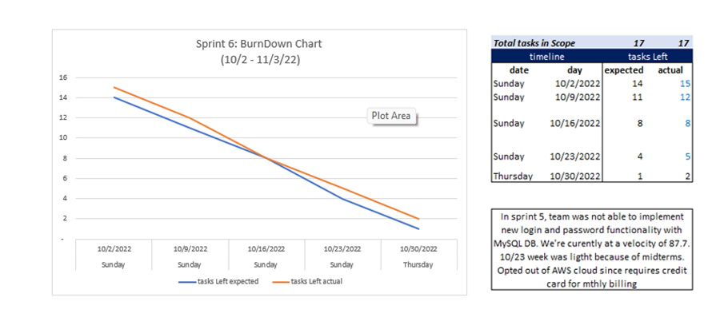
Sprint 6:
User login feature has been implemented
Invest in this company button will redirect user to third party where user can now invest into stocks.
PNG-formatted graphs can be downloaded to give users access to more stock insights.
The sequence of historical data in tabular form has been changed so that users can view the most recent data first and then older data.

Slide 19
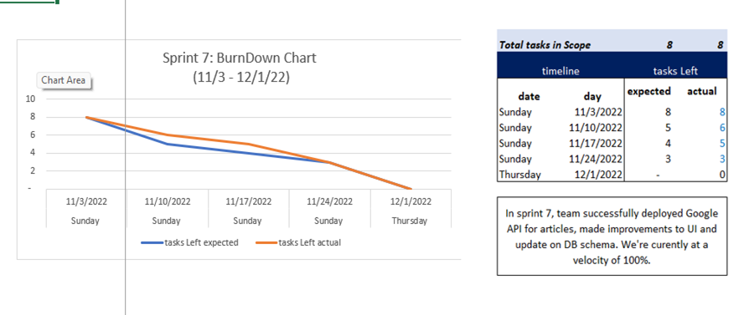
Sprint 7:
Improved UI for login-page and sign-up page.
Added search history tab for registered users.
Implemented a new headlines section for users to know more about companies current scenario.
The sequence of historical data in tabular form has been changed so that users can view the most recent data first and then older data.

Slide 20
SPRINT 7 VS SPRINT 8
SPRINT 7
Improved UI for login-page and sign-up page.
Added search history tab for registered users.
Implemented a new headlines section for users to know more about companies current scenario.
The sequence of historical data in tabular form has been changed so that users can view the most recent data first and then older data.
SPRINT 8
Enhanced the UI on console page.
Added date range filter for better analysis of the stock trends and companies financial history.
Notes:
Change this

Slide 21
IMPROVEMENTS MADE FROM PROFESSOR FEEDBACK
Update the Acceptance criteria with “given, when & then” keywords (For User story - AS A, WANT TO, SO THAT ). (Page 24)
Can use bullet points for acceptance criteria.(Page 24)
Put the slide number for the professor feedback slide.(Done)
Team velocity needs improvement.(Page 29)
Notes:
Samarth

Slide 22
PRODUCT BACKLOG
JIRA ID | Description | Priority | Point | Status | Sprint
SRIW-112 | As a New social Investor i want to have a wishlist for the companies i have invested in or companies i plan to invest in, so that i can keep a track on the companies of my interest. | Medium Priority | 3 | Not Complete | Sprint 8
SRIW-113 | As a Long-term investor Carlos wants to have a date range filter so that, he can analyze the data for the specific date range. | High Priority | 5 | Completed | Sprint 8
SRIW-114 | As a Investment advisor i want to Be able to share my wishlist portfolio to my clients so that, my client can refer to the companies and the data related with them for their reference. | Medium Priority | 3 | Not Complete | Sprint 8

Slide 23
SPRINT BACKLOG
Sprint | JIRA ID | Description | Priority | Point | Status | Goal Date
Sprint 8 | SRIW-112 | As a New social Investor i want to have a wishlist for the companies i have invested in or companies i plan to invest in, so that i can keep a track on the companies of my interest. | Medium Priority | 3 | Not Complete | 12/11/2022
Sprint 8 | SRIW-113 | As a Long-term investor Carlos wants to have a date range filter so that, he can analyze the data for the specific date range. | High Priority | 5 | Completed | 12/12/2022
Sprint 8 | SRIW-114 | As a Investment advisor i want to Be able to share my wishlist portfolio to my clients so that, my client can refer to the companies and the data related with them for their reference. | Medium Priority | 3 | Not Complete | 12/15/2022
Sprint 8 | SRIW-123 | Update Technical paper, Installation manual and User manual. | Medium Priority | 3 | Completed | 12/16/2022
Sprint 8 | SRIW-124 | Create Deliverable 8 presentation. | High Priority | 5 | Completed | 12/16/2022
Sprint 8 | SRIW-125 | Record Deliverable 8 presentation and edit. | High Priority | 5 | Completed | 12/17/2022
Sprint 8 | SRIW-124 | Update Wiki Page. | Medium Priority | 3 | Completed | 12/18/2022

Slide 24
USER STORY & ACCEPTANCE CRITERIA
SRIW 113
User Story:
As a Long-term investor Carlos wants to have a date range filter so that, he can analyze the data for the specific date range.
Acceptance criteria:
Given: that the investor is already on the Console page.
When: he enters the company name and select a specific date range in the date range button besides the search box.
Then: he can see the data for specified date range in history data tab.

Slide 25
SPRINT 8: TEST CASES
USER STORY ID | TEST CASE ID | TEST CASES | EXPECTED RESULT | PASS/FAIL | TEST DATA
SRIW-113 | SRIW-125 | Have a date range filter | When Clicked on date button you can see the calendar below the button | Pass | User is able to see calendar to select date range
SRIW-113 | SRIW-126 | Have a date range filter | After selecting the date range we can see the data for specific date | Pass | Once the date rage is selected we can see the data to be visible for the specific date range
Notes:
Jephthe

Slide 26
STORIES COMPLETED
USER STORY ID | AS A | I WANT TO | SO THAT | Acceptance Criteria
SRIW 113 | Long-term Investor | Have a date range filter | he can analyze the data for the specific date range | Given: that the investor is already on the Console page When: He enters the company name and select a specific date range in the date range button besides the search box. Then: He can see the data for specified date range in history data tab.

Slide 27
STORIES NOT COMPLETED
USER STORY ID | AS A | I WANT TO | SO THAT
SRIW 112 | New social Investor | Have a wishlist for the companies i have invested in or companies i plan to invest in | I can keep a track on the companies of my interest
SRIW 114 | Investment advisor | Be able to share my Wishlist portfolio to my clients | My client can refer to the companies and the data related with them for their reference
Notes:
Kush

Slide 28
METRICS
TEAM VELOCITY
BURNDOWN CHARTS
COMMITTED/ COMPLETED RATIO
Notes:
Jeph

Slide 29
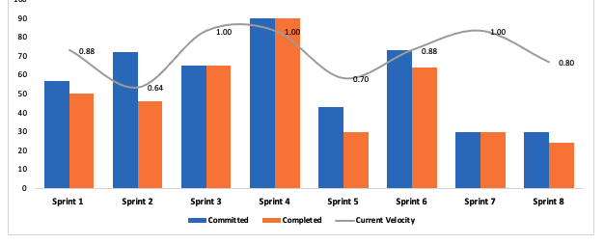
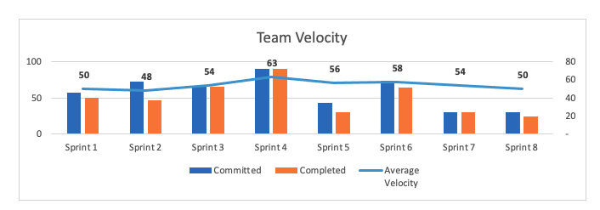
SPRINT 8: Team Velocity
Notes:
Jephthe

Slide 30
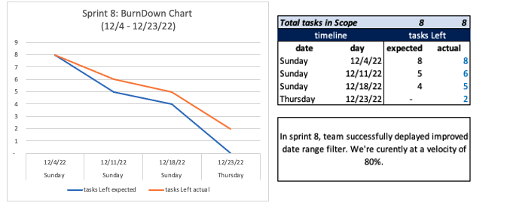
SPRINT 8: BURNDOWN CHART
Notes:
Jephthe

Slide 31
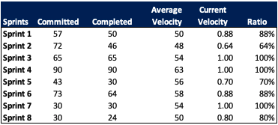
SPRINT 8: METRICS
Notes:
jeph

Slide 32
RETROSPECTIVES

Slide 33
WHAT WENT WELL | WHAT NEEDS IMPROVEMENT | NEXT STEPS | Votes (OUT of 6)
- We finished the project within the time constraint identified early in the semester | - Better time management for debugging QA feedback in addition to working on new tasks and required user stories | -Attempting to measuring how long it takes to debug issues that arise in order to consider escalation time in addition to time needed for tasks | 6
- Team communicated their individual tasks and kept everyone informed on their progress during stand up meetings | - All the documentation/notes related the sprint and/or project should be documented on a online platform for future reference when needed. | - Upload all individual files to Google drive and share the link with the team | 5
Notes:
Jephthe

Slide 34
PROJECT DEMO
Notes:
Harshal

Slide 35
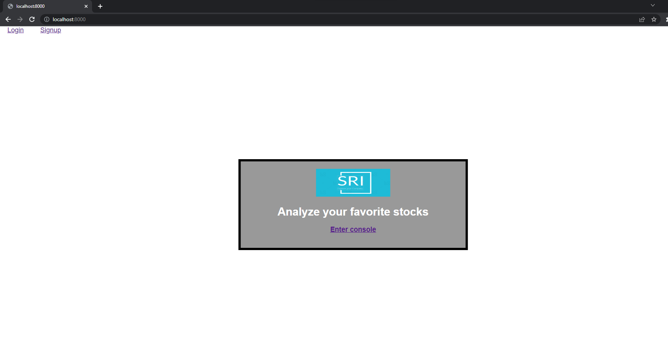
SCREENSHOTS OF THE WEBSITE

Slide 36
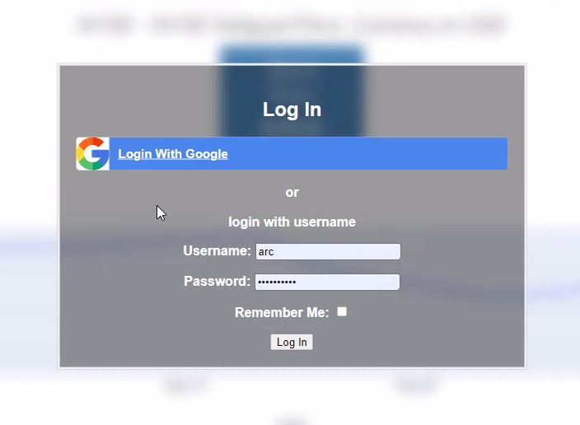
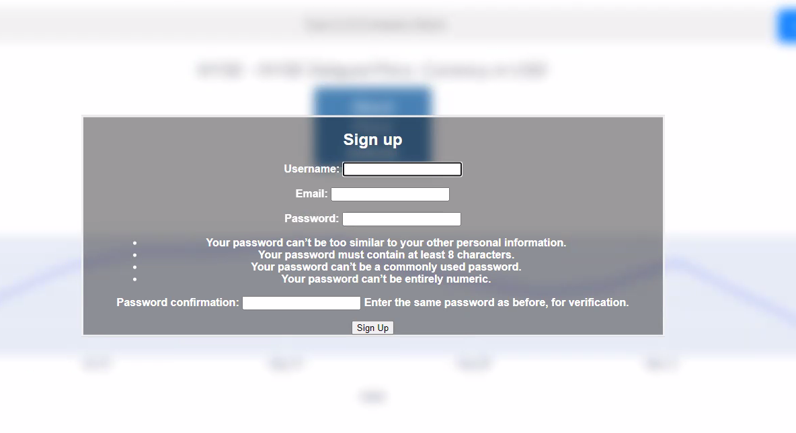
SCREENSHOTS OF THE WEBSITE

Slide 37
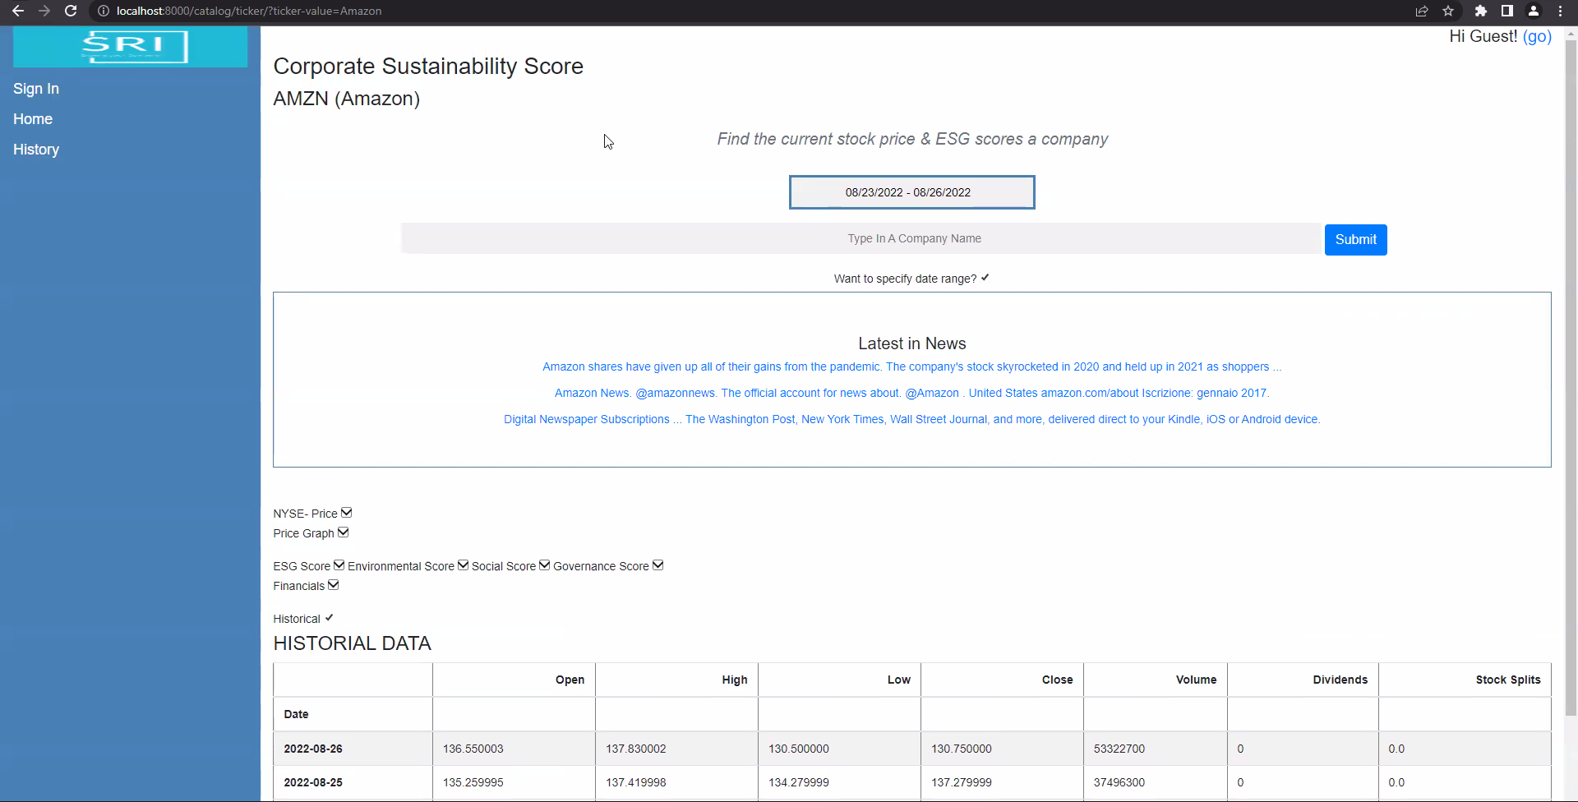

Slide 38
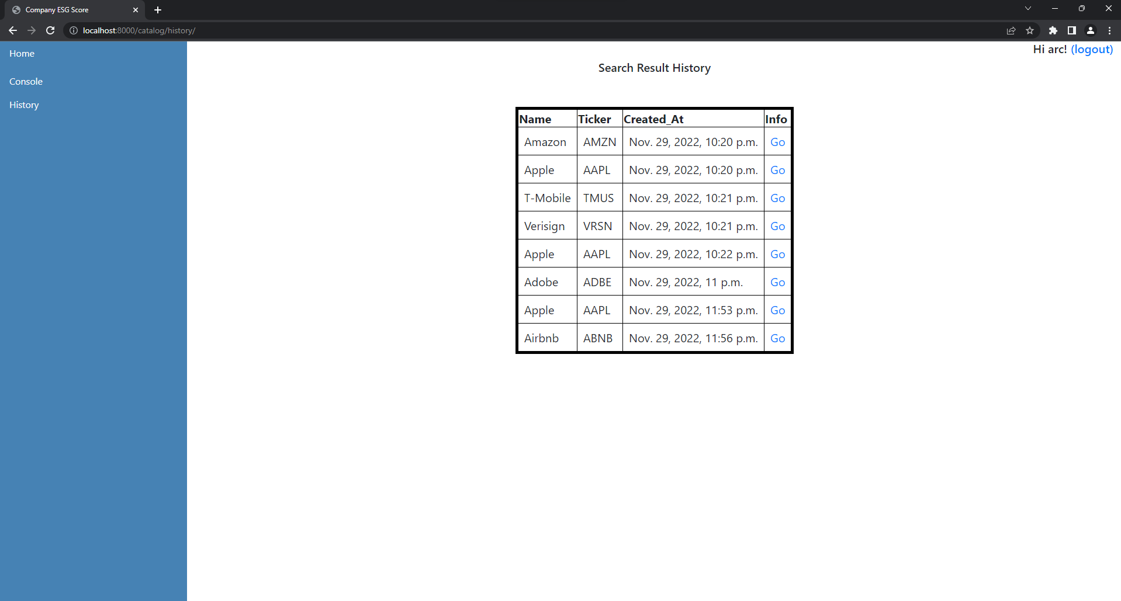
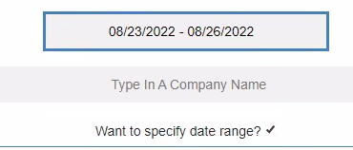

Slide 39


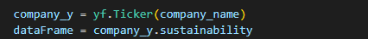
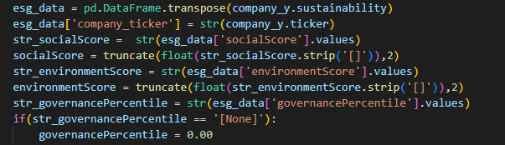
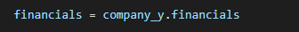

SCREENSHOTS OF THE API

Slide 40
GITHUB LINK
https://github.com/CS691/Socially-Responsible-Investing-A-financial-website/wiki

Slide 41
THANK YOU!
Notes:
Hashal

